Slide 1
Introduction to CSS
Prepared by Saran Adhikari(L4CG6)
Web Technologies

Slide 2
Contents
What is CSS?
Ways To Style Your Webpage
How a CSS Syntax is Divided
Visual Representation of Selector ,Property and Value
Linking CSS and HTML together
CSS Selectors and its types
Universal Selector, Element Selector, ID Selector, Class Selector, Attribute Selector
Reference

Slide 3
What is CSS?
CSS is the acronym for "Cascading Style Sheet“
CSS is the language we use to style an HTML document.
It describes how HTML elements should be displayed.
It helps user to customize their webpages on the basis of different attributes and styles.

Slide 4

Ways To Style Your Webpage
EXTERNAL | INTERNAL | INLINE
A CSS document written in a separate file and then linked then to HTML | Customization done in the HTML file itself which is enclosed by a <style>tag | CSS written as an attribute in the HTML document.

Slide 5
How a CSS Syntax is Divided?
It can be divided into three parts:
1. SELECTOR
2. PROPERTY
3. VALUE

Slide 6
Visual Representation of selector, property and value
selector{ property: value; }

Slide 7
Linking CSS and HTML Together
Inline CSS:
<div style=“border”: 1px solid #000”; This has a border</div>
Internal CSS:
<style>div{border: 1px solid #000; }</style>
External CSS:
<link href=“cssfile.css” rel=“stylesheet”>

Slide 8
CSS Selectors and its Type
CSS selectors are used to focus on HTML elements which we want to style.
It is a component of CSS declaration and has five types.

Slide 9
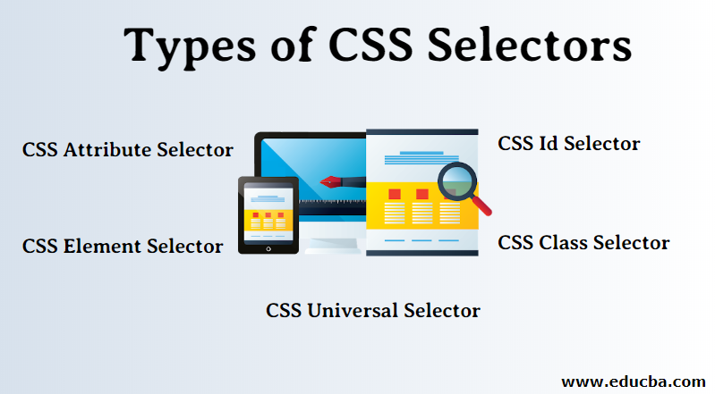

Slide 10
Universal Selector
*{
color: blue;
font-size:
10px;
}

Slide 11
Element Selector
ul{
border: 1px solid
#ccc;
font-size: 10px;
}

Slide 12
ID Selector
<header id=“header”></header>
#header{
border: 1px solid
#ccc;
font-size: 12px;
}

Slide 13
Class Selector
<div class=“container”></div>
.container{
margin: 0
auto;
width:
150px;
}

Slide 14
Attribute Selector
<input type=“text”>
Input[type=“text”]{
font-size;
10px;
line-height:
1.0;
}

Slide 15

THANK YOU!

Slide 16
REFERENCES:
https://youtu.be/BaXrFsVHgtk
https://www.educba.com/types-of-css-selectors/
https://stock.adobe.com/sg/search?k=thank+you
https://www.google.com/url?sa=i&url=https%3A%2F%2Fwww.freepnglogos.com%2Fpics%2Fhtml5-logo&psig=AOvVaw0toxfUJHDgP0GGvbU8L9Tf&ust=1670953858165000&source=images&cd=vfe&ved=0CBAQjRxqFwoTCOCjqcPS9PsCFQAAAAAdAAAAABAD

